Slide 1

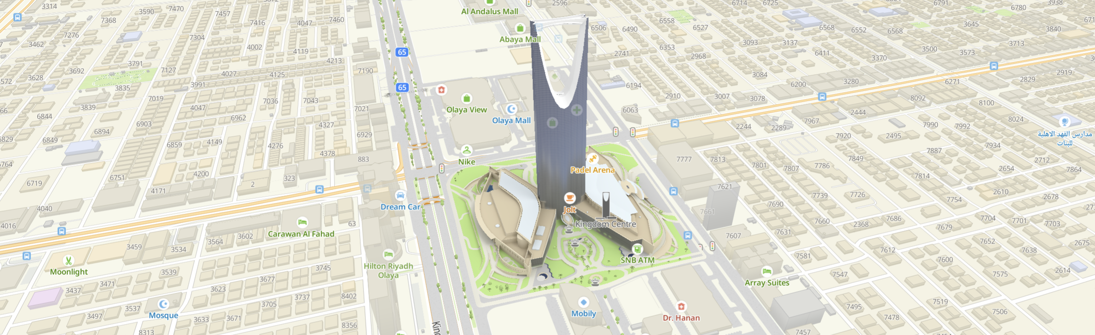

RIYADH MOMRA DATA AUDIT
April 2024

Slide 2
Objectives
Overview
Criteria assessed
Audited Areas
Audit Territories
Errors Calculation Methodology
Error details & examples
Audit Analysis
Calculations Formulas
Audit Data table summary
Conclusion & most found errors

Slide 3
Objectives
Obtaining a realistic and objective understanding of MOMRA data quality
Drawing up an action plan for the production department aimed at improving the quality of the product.

Slide 4
Criteria assessed
Completeness
Accuracy
Reliability
Completeness reflects the presence of an organization/object on the territory.
Accuracy reflects how correctly and sufficiently the information is presented.
Reliability reflects how many companies or map objects were not found

Slide 5
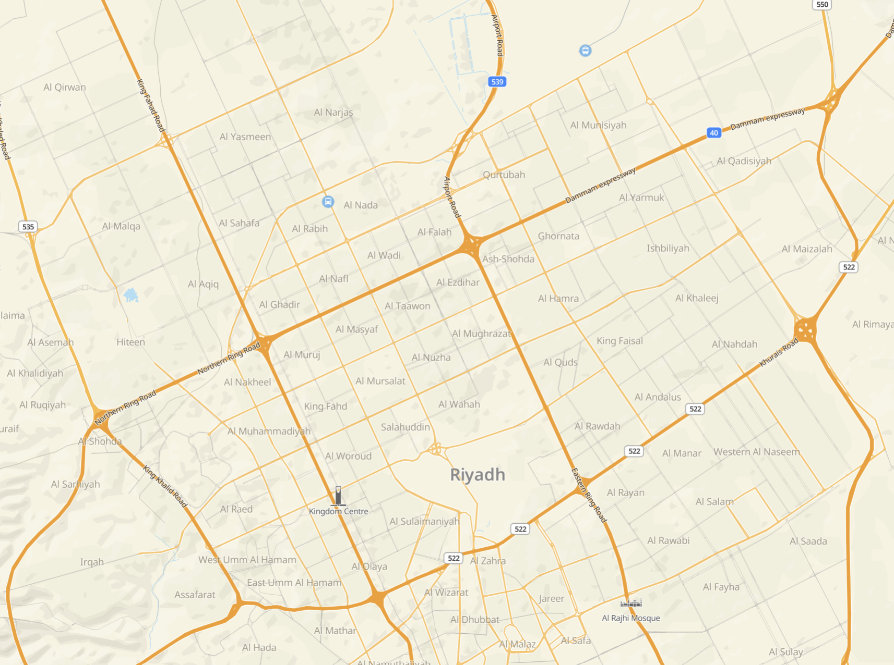
Al Yasmeen District
Al Sahafa District
Audited Areas
Al Rabih District
King Abdullah District

Slide 6
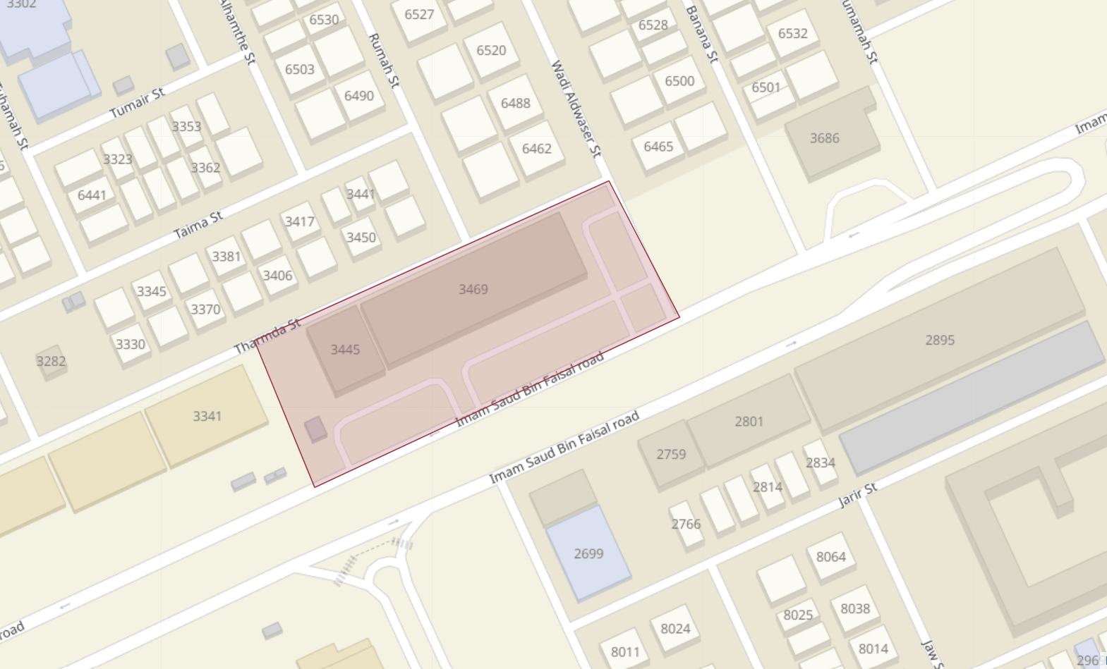
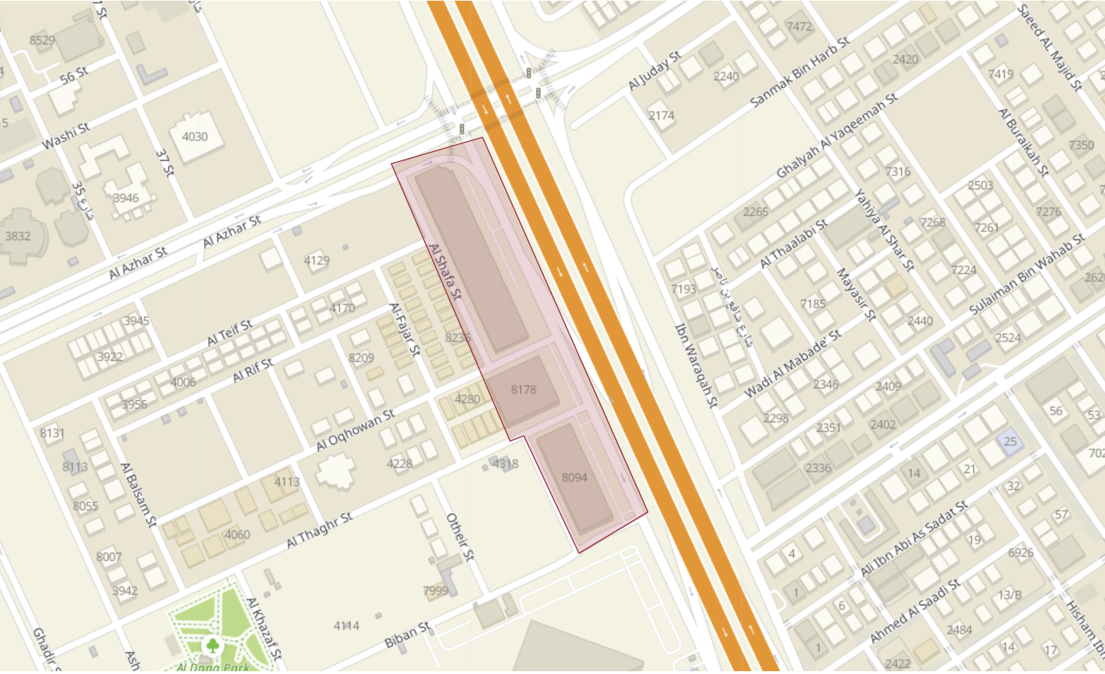
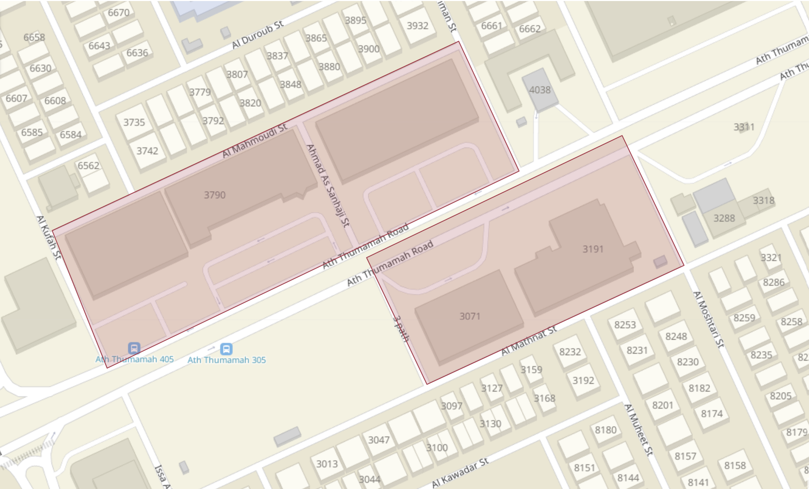
The scope of one check is the territory verified by a specialist in 0.5-1 day. It can be one whole territory or several parts of different territories.
Audited territories
Al Sahafa District
King Abdullah District
Al Yasmeen District & Al Rabie District

Slide 7
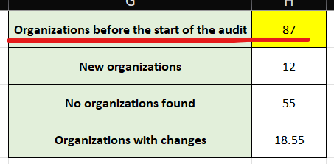
Errors calculation Methodology
1- We Mark the territory on the "Audit" tab in YouLa, upload tasks to the mobile device
2- Determine the total number of firms in the territory. The total number of objects should be counted as all the scanned organization in the territory of the audit. The information have to recorded in the audit report.
3- We make a visit to the territory and check all or organization. Record errors in mYouLa.
4- Upon returning to the office, we calculate the total weight of errors (most errors from reconciliation will be considered gross and worth 1 point)
Al Sahafa District

Slide 8
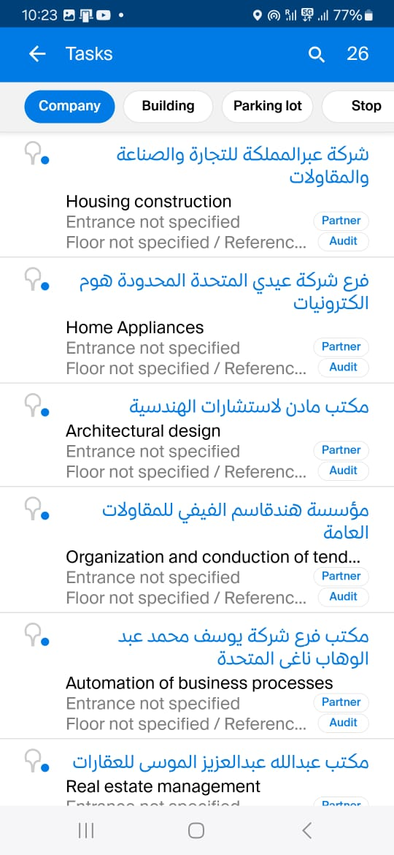
No of Companies
Error details & examples
Partner Cards for Audit
Partners cards are loaded into mYoula and Audit was performed on the Partner companies only

Slide 9
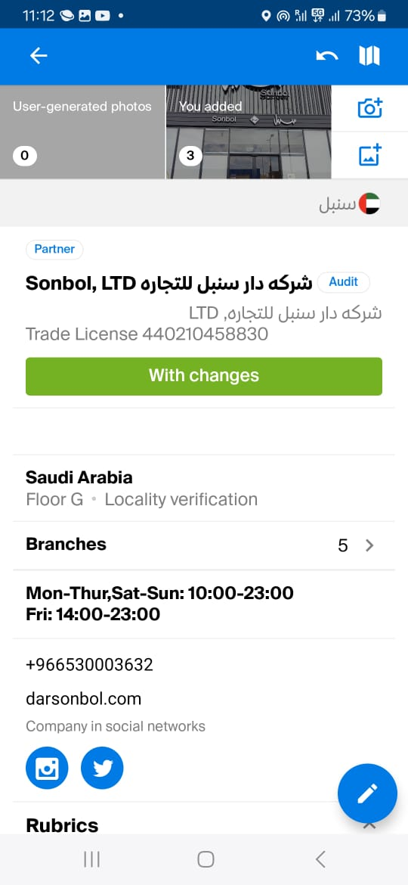
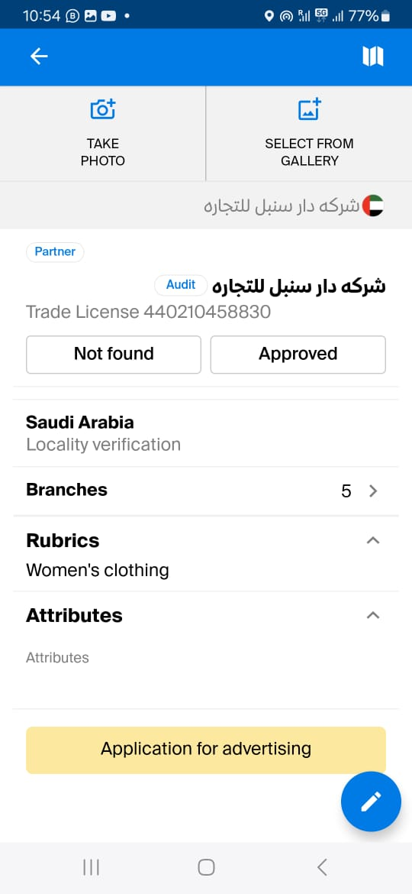
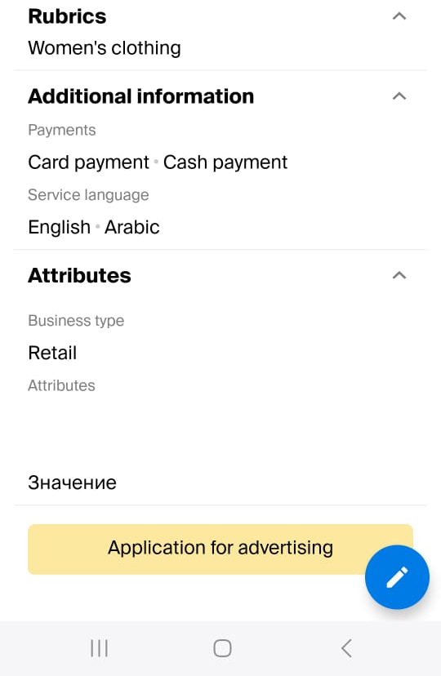
Error details & examples
Error was calculated based on:
1- incorrect name
2- Incorrect legal name
3- Added/updated Trade License
4- Incorrect address
5- Error/Added landmark (floor)
6- Error in the organization's operating time
7- "Temporarily closed" or "Opening soon" missing/incorrect
8- Added/updated phone number
9- Added/updated website, social networks, messengers
10- Category updated
11- Additional attributes adjusted
12- Payment methods adjusted
Updated Info
Added Info
Added Info
After
Before

Slide 10
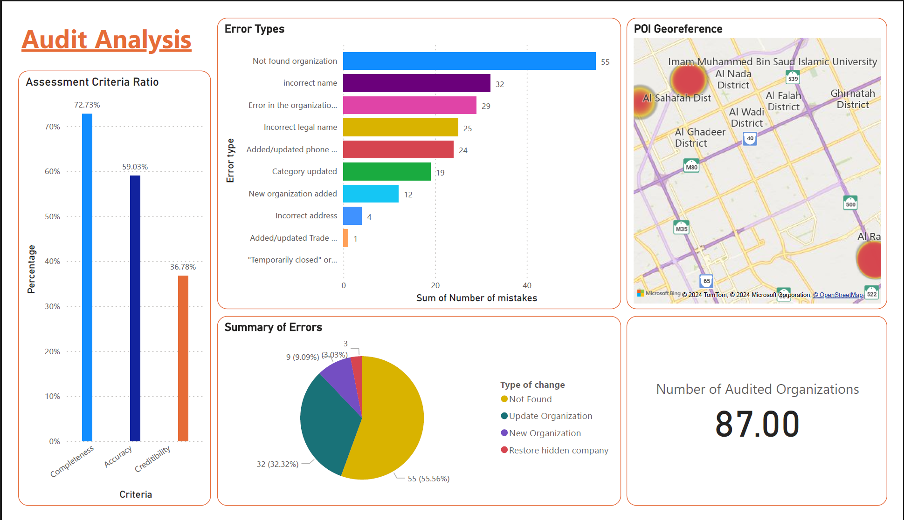

Slide 11
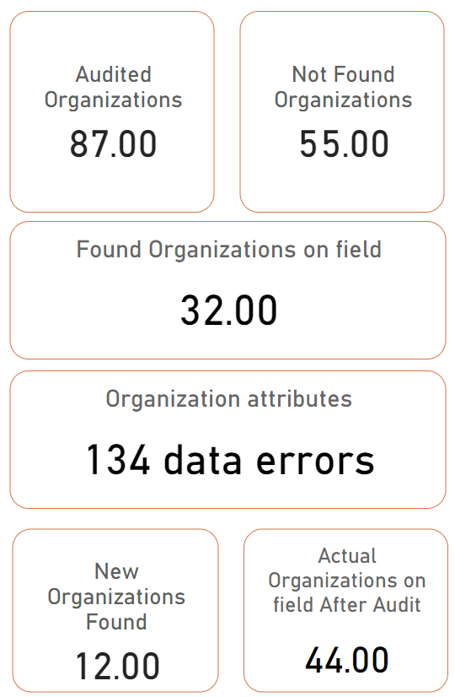
Calculations Formulas
n – Not found Firms
Completeness =
n – Not found Firms + New Firms
Where n = Number of audited organizations
87 – 55
Completeness = = 72.73%
87 – 55 + 12
32 found firm on field from MOMRA data out of 44 with a completeness level of 72.73%

Slide 12
Calculations Formulas
Incorrect firms attributes * error weight
Accuracy = 1 –
Found Firms
18.55
Accuracy = 1 – = 59.03%
32
13.11 weighted firms error out of 32 from MOMRA data with an accuracy level of 49.03%

Slide 13
Calculations Formulas
Not found Firms
Creditability = 1 –
n
Where n = Number of audited organizations
55
Creditability = 1 – = 36.78%
87
55 not found firms out of 87 audited organizations from MOMRA data with a creditability level of 36.78%

Slide 14
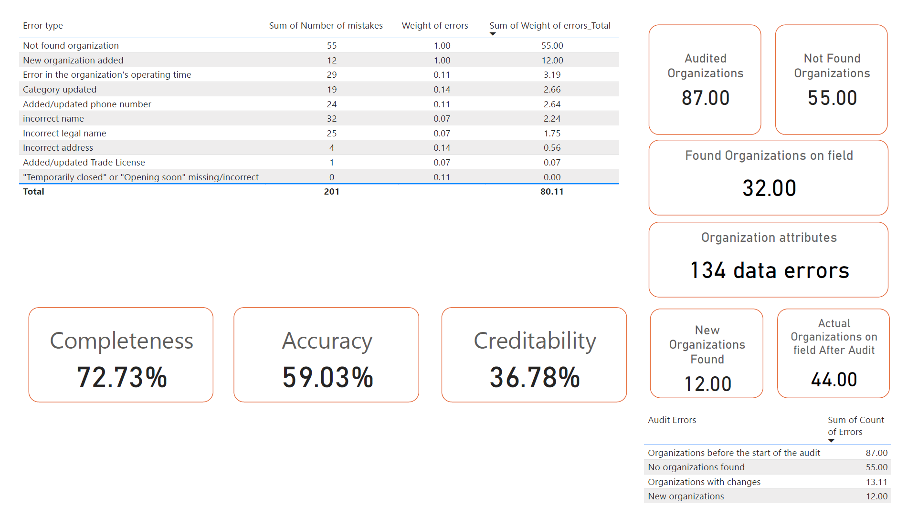
Audit Data
Table Summary

Slide 15
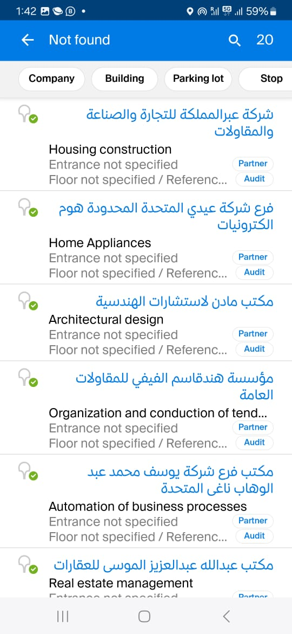
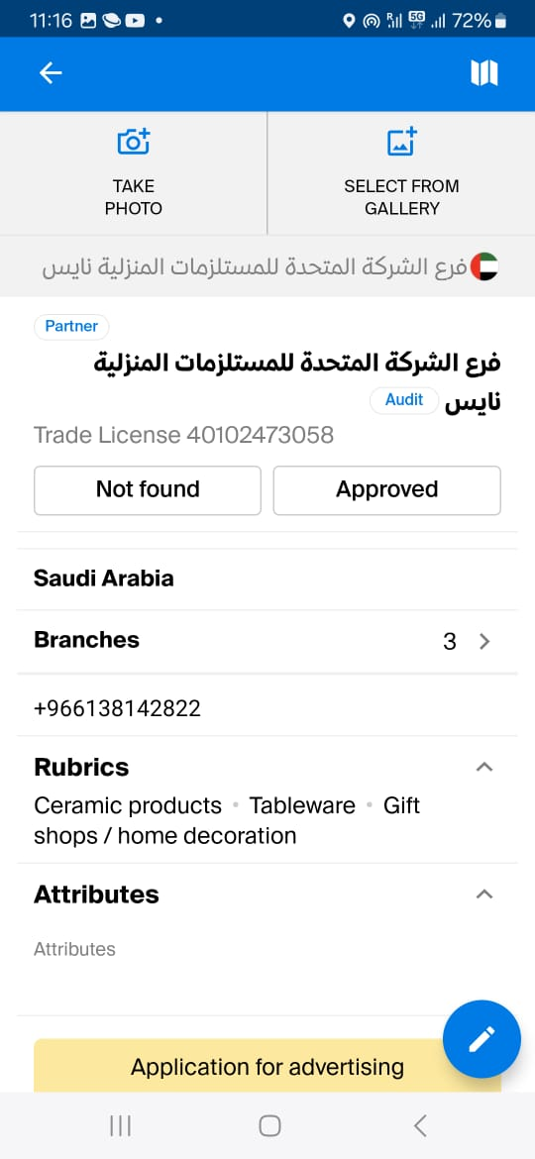
Conclusions & most found errors
1- Most of company names are only the legal name and missing brand name
2- some company categories are incorrect
3- Contact numbers are incorrect
4- Most of companies are not found

